Slide 1

Predicting Vehicle Collision Severity
Andres Michel

Slide 2
Abstract
Vehicle collisions are a leading cause of death both in the World and in the U.S. Therefore, being able to understand the variables directly related to an increase in the odds of having a Severe car crash, over a non Severe one is of high importance.

Slide 3
Introduction
During 2019, almost 40 thousand people lost their lives to car crashes solely in the U.S. and even though in recent years the mortality rate has been declining, it is still a leading cause of death. The odds of dying in a car crash in the US are of one in 103.
Being able to identify and predict when car crashes will occur, allows people to avoid certain roads, take extra precautions when driving under certain weather conditions and even alert authorities and manufacturers of trends and risk factors that could translate into policies and design improvements to help save lives.

Slide 4
Data
We’ll be using the Seattle GIS collision data, provided by the City of Seattle. All data was obtained by SPD and recorded by Traffic Records. This includes all types of collisions. Collisions will display at the intersection or mid-block of a segment. Time frame: 2004 to Present.

Slide 5
Data
The data consists of 37 attributes and 194,673 rows (or accidents), with information ranging from Incident ID to Weather and Light conditions. Thus, in order to work with the data we’ve proceeded to clean it up, removing rows with missing data and removing redundant columns. After cleansing the data, we ended up with 182,660 rows.

Slide 6
Data preparation
Activites related to Data preparation:
Clean Data set: remove non-useful attributes and empty values.
Prepare Data set: Encode categorical variables, change data types
Feature selection: Select the relevant features

Slide 7
Exploratory Data Analysis
In this section we performed a series of analysis, mainly visuals, to understand the behaviour of the data depending on certain parameters. For instance, we did several groupBy() functions, in order to make some of the plots shown below, as this helped us to understand how each attribute had an influence in the severity of an accident

Slide 8
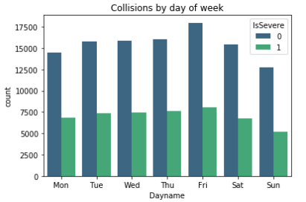
Exploratory Data Analysis
We proceeded to make some sense of the data by trying to identify the seasonality of the severe collisions.

Slide 9
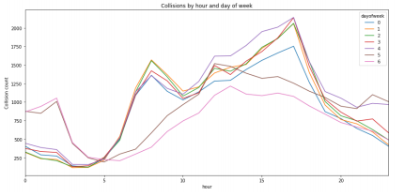
Exploratory Data Analysis
we can identify a common trend, as more collisions are registered during Friday, and less on Sunday. Same can be said from Hour of day, where most accidents occur during midnight as well as in the afternoon.

Slide 10
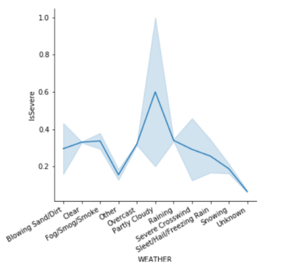
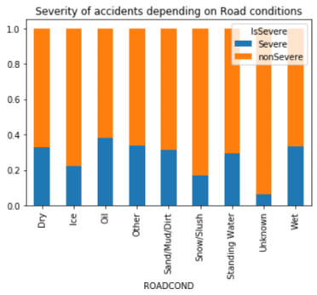
Exploratory Data Analysis
This is also true for weather conditions and road conditions:

Slide 11
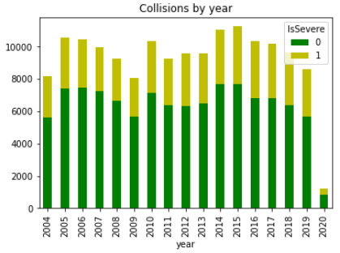
We also identified a declining trend in the total number of Collisions during the past 5 years.

Slide 12
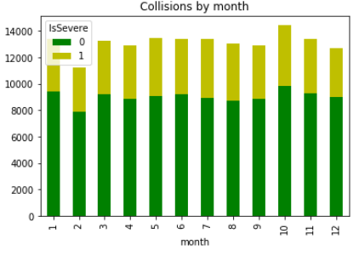
Exploratory Data Analysis
Also a high number of accidents occurring in October:

Slide 13
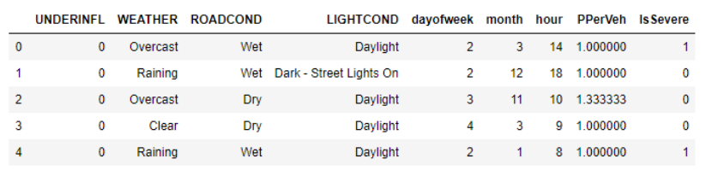
Feature selection
After concluding with the exploratory analysis we ended up with a set of features as follows, where PPerVeh stands for the number of people per vehicle:
Categorical variables were processed with one-hot encoding in order to be used in the model training phase.

Slide 14
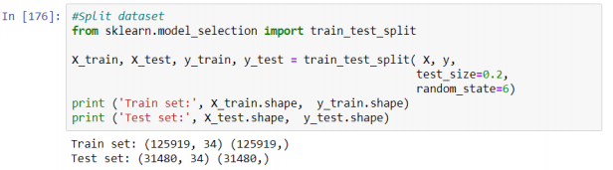
Test and training set selection
For the dataset splitting, we used the Sklearn train-test-split library, as it simplifies our task to randomly splitting the data into both train and test sets.

Slide 15
Predictive Modeling
In order to predicting the chances of a Severe collision to occur, we decided to use classification algorithms. We had a particular interest in trying out the Logistic regression approach as it allowed us to actually calculate probabilities. However, we also tried out several other models 8 such as SVM, Decision Trees and KNN, in order to make a comparison between the outcome of these models.

Slide 16
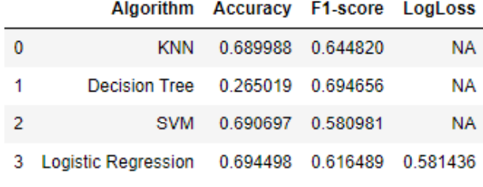
RESULTS

Slide 17
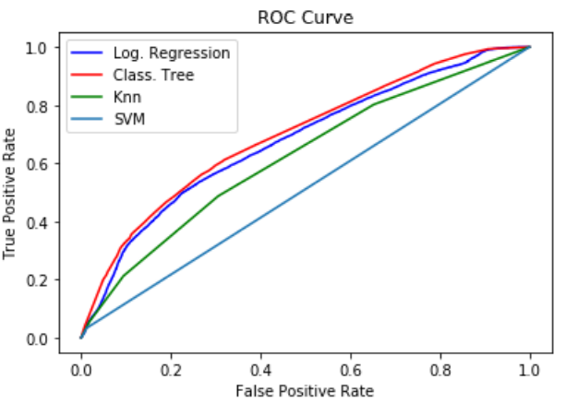
RESULTS

Slide 18
Discussion
Throughout the implementation and execution of several algorithms we had some issues regarding performance, this was particularly true for KNN and SVM algorithms.
in order to reduce variance bias we could’ve implemented the K-fold cross validation method, however due to the performance it was not attempted.

Slide 19
Discussion
I believe the model can be further improved, and surely this will produce much better predictive capabilities.
This would require a better understanding of the SPD codes being used, and possibly to further reduce the scope of the predictive outcome, meaning make it more specific, in order to have a better predictive model.

Slide 20
Conclusion
Working with real world data is complex problem. The mastery of a Data scientist is mostly determined by his ability to produce useful information, from a large data set, to be used by the models. Meaning that the hard work of cleaning, preparing and making sense of the data is most of what is required to build a useful, reliable predictive model.

